Slide 1
Module 2 - Syllabus
Handling Big Data
Distributed and parallel computing(map reduce) for Big Data, Introducing Hadoop, Cloud computing and Big Data, In-memory Computing Technology for Big Data.
Understanding Hadoop Ecosystem:
Hadoop Ecosystem, Hadoop Distributed File System, MapReduce, Hadoop YARN, Introducing HBase(db), Combing HBase and HDFS, Hive(query language), Pig(script) and Pig Latin, Sqoop, Zookeeper ,Flume, Ozie.

Slide 2
Schedule – Sec A
Mid 1 Exam
Date – 08-01-2024(Monday)
Venue – B407
Time – 8:30 A.M.
Syllabus – Module 1 and Module 2(Till In-memory Computing Technology for Big Data Concept)

Slide 3
Schedule – Sec G
Mid 1 Exam
Date – 12-01-2024(Friday)
Venue – B407
Time – 10:15 A.M.
Syllabus – Module 1 and Module 2(Till In-memory Computing Technology for Big Data Concept)

Slide 4
Evaluation Criteria - Theory
Criteria | Marks
Mid Exams | 30M
Assignment | 5M
Quiz | 5M
Total | 40M

Slide 5
Evaluation Criteria - Lab
Criteria | Marks
Continuous Evaluation | 60M
Lab Exam 1 | 15M
Lab Exam 2 | 15M
Case Study | 10M
Total | 100M

Slide 6
About Module 2
In Module 1 ->
Huge amounts of data generated by different sources -
Huge data cannot be handled by traditional data storage
Huge data need to be managed properly.
Based on the requirement, development of various technologies used for processing Big Data.

Slide 7
About Module 2
In Module 2->
To handle, process and analyse big data, the most effective and popular innovations have been in the fields of distributed and parallel processing, Hadoop, In-Memory Computing(IMC), Big data cloud etc.
Hadoop is the most popular technology associated with Big Data storage and processing different types of data.
Cloud computing helps businesses to save cost and manage their resources by allowing to use their resources as a service and paying only for the used services.
IMC used to organize and complete the tasks faster by carrying out the computational activities from the main memory itself.

Slide 8

About Module 2
Among the technologies that are used to handle, process and analyze big data the most popular and effective innovations have been in the field of distributed and parallel processing, Hadoop, in memory computations, big data cloud.
Most popular:-Hadoop
Organizations use it to extract maximum output from normal data usage practices at a rapid pace.
Cloud computing helps companies to save cost and better manage resources.

Slide 9

Big Data
Big Data can’t be handled by traditional data storage and processing systems.
For handling such type of data, Distributed and Parallel Technologies are more suitable.

Slide 10
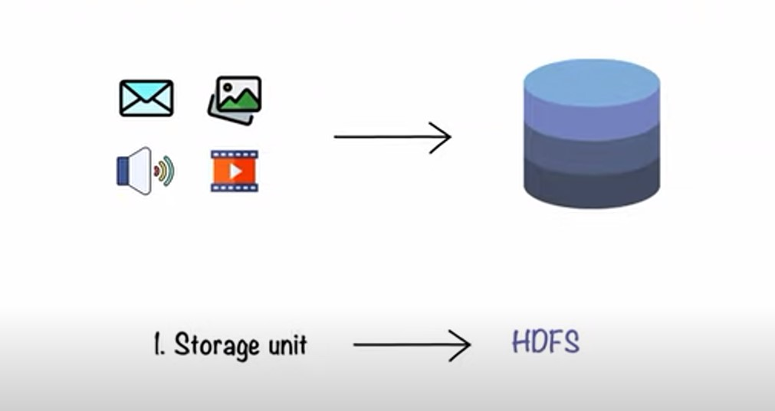
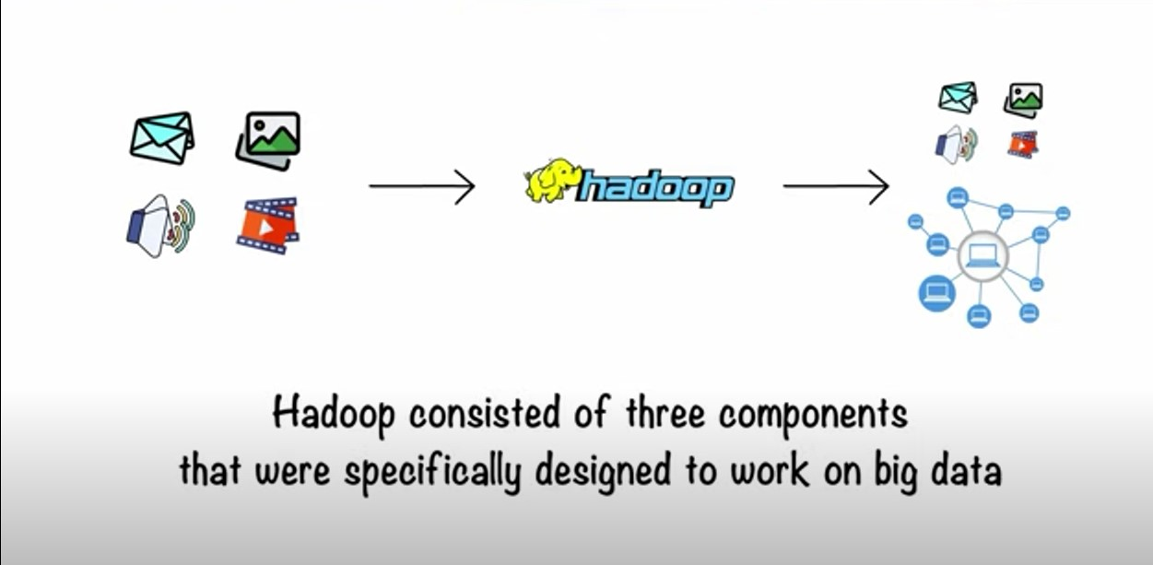
HDFS

Slide 11
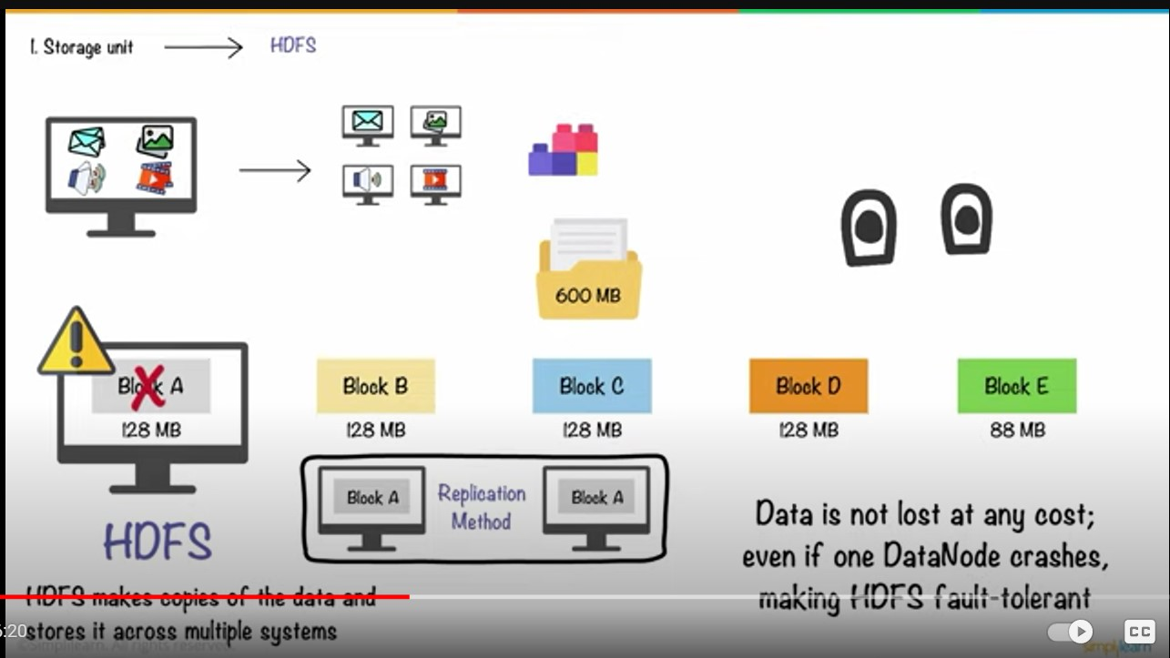

Slide 12
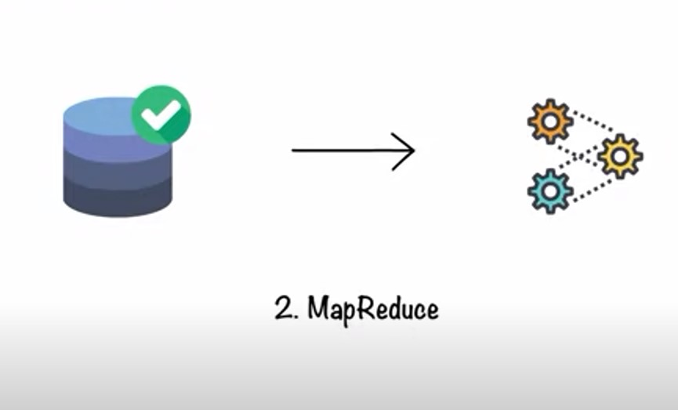
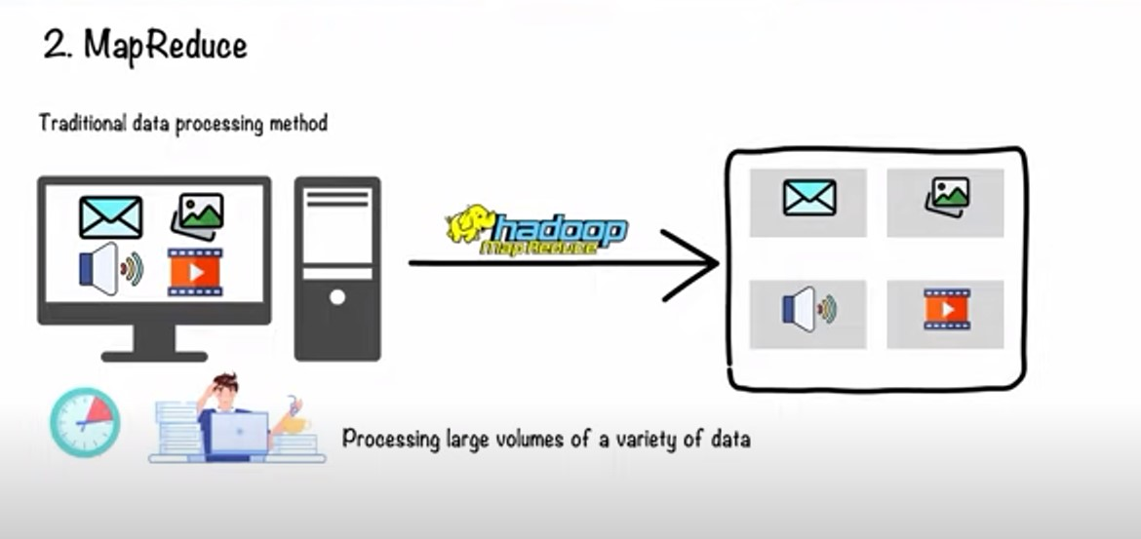
Map reduce

Slide 13
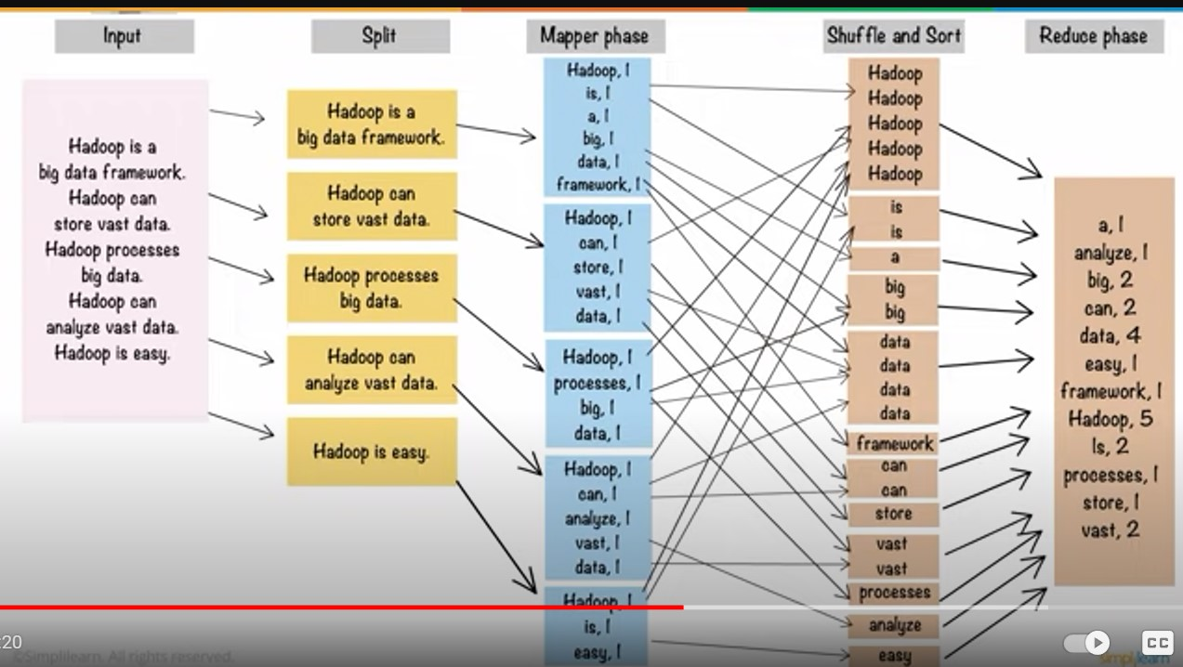
Map Reduce Example

Slide 14
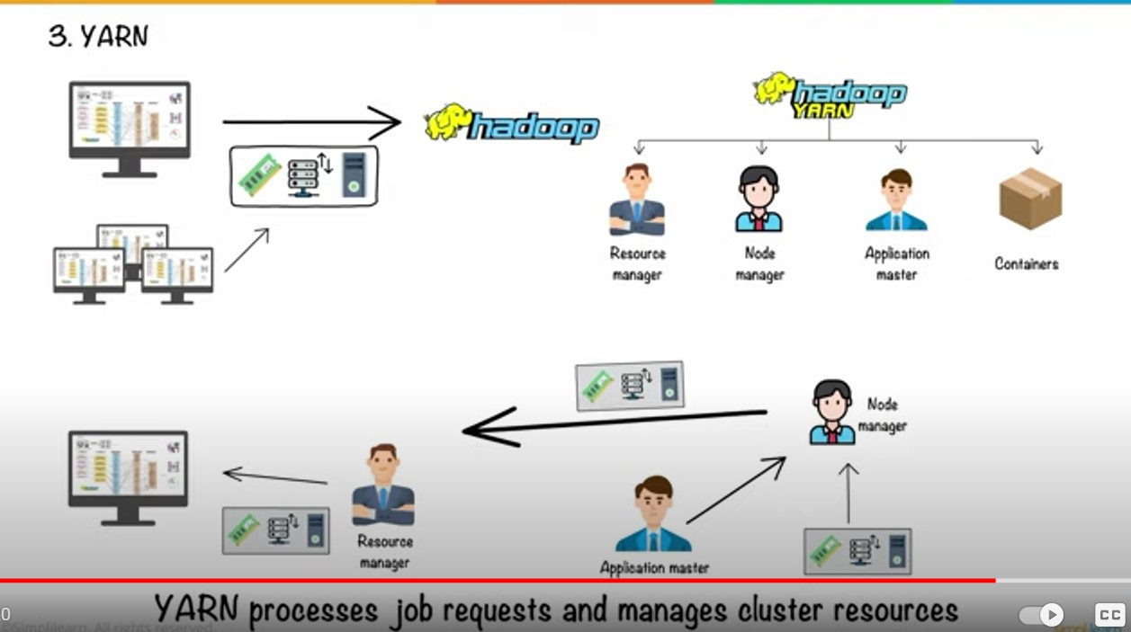
YARN(Yet Another Resource Negotiator)

Slide 15
Parallel Computing and Distributed Computing
Parallel Computing
A computer system may perform tasks according to human instructions.
A single processor executes only one task in the computer system, which is not an effective way.
Parallel computing solves this problem by allowing numerous processors to accomplish tasks simultaneously.
Modern computers support parallel processing to improve system performance.

Slide 16
Parallel Computing and Distributed Computing
Distributed Computing
Distributed computing enables several computers to communicate with one another and achieve a goal.
All of these computers communicate and collaborate over the network.
Distributed computing is commonly used by organizations such as Facebook and Google that allow people to share resources.

Slide 17
Distributed and Parallel Computing for Big Data
Distributed computing is a method in which multiple computing resources are connected in a network and computing tasks are distributed across the resources, thereby increasing the computing power. Distributed computing is faster and more efficient than traditional computing, and, hence, of immense value when it comes to processing a huge amount of data in a limited time.
To carry out complex computations, the processing power of a standalone personal computer can also be enhanced by adding multiple processing units, which can carry out the processing of a complex task by breaking it up into sub-tasks, and carrying out individual sub-tasks simultaneously. Such systems are often termed as parallel systems. The greater the processing power, the faster the computing.

Slide 18
Distributed and Parallel Computing for Big Data
Distributed Computing System | Parallel Computing System
An independent, autonomous system connected in a network for accomplishing specific tasks | A computer system with several processing units attached to it
Coordination is possible between connected computers that have their own memory and CPU | A common shared memory can be directly accessed by every processing unit in a network
Loose coupling of computers connected in a network that provides access to data and remotely located Resources | Tight coupling of processing resources that are used for solving a single, complex problem

Slide 19
Distributed Computing and Parallel Computing
Parallel Computing
Multiple processors performs multiple tasks assigned to them simultaneously.
Memory in parallel systems can either be shared or distributed.
Parallel computing provides concurrency and saves time and money.
Distributed Computing
Multiple autonomous computers which seems to the user as single system.
There is no shared memory and computers communicate with each other through message passing.
A single task is divided among different computers.

Slide 20
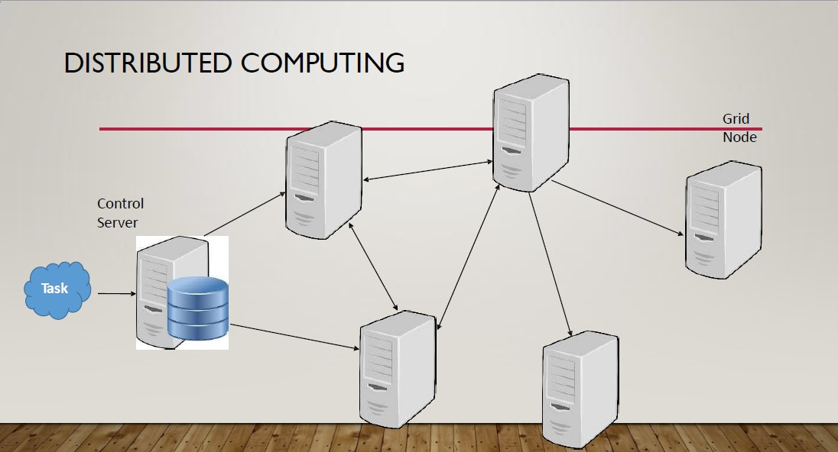
Distributed and parallel computing for Big Data
In distributed computing, multiple resources are connected in a network and computing tasks are distributed across these resources.
increases the speed
Increases the efficiency
More suitable to process huge amounts of data in a limited time

Slide 21
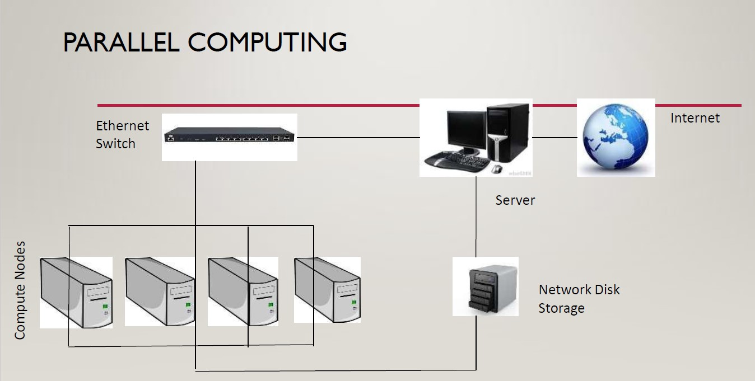
Distributed and parallel computing for Big Data
Improves the processing capability of a computer system is to add computational resources to it.
Divide complex computations into subtasks – to handle processing units individually that are running in parallel.
In short, processing capability will increase with the increase in the level of parallelism.

Slide 22
Big Data Processing Techniques
With the increase in data, forcing organizations to adopt a data analysis strategy that can be used for analyzing the entire data in a very short time.
Done by powerful hardware components and new software programs.
The procedure followed by the software applications are:
1)Break up the given task
2)Surveying the available resources
3)Assigning the subtask to the nodes

Slide 23
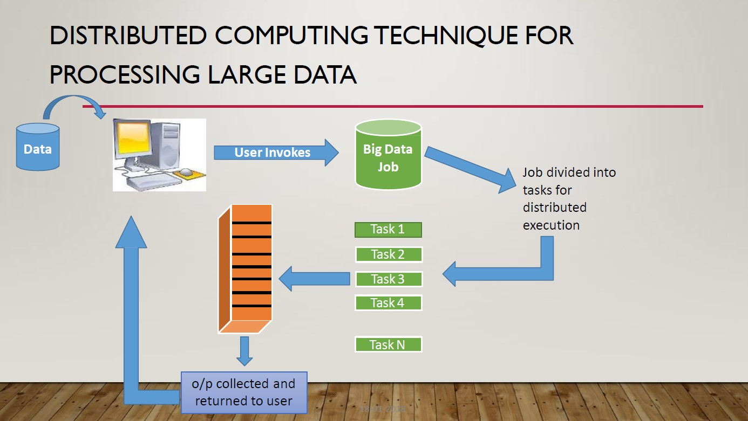

Slide 24

Distributed Computing Technique for Processing Large Data
Nodes are arranged within a system along with the elements that form the core of computing resources i.e., CPU,memory,disks etc
As Big data systems require higher scale requirements , these nodes are more beneficial for adding scalability to Big Data environment.
Scalability
With added scalability, more amount of data can be accommodated efficiently and flexibly.
Distributed computing technique makes use of Virtualization and Load balancing features.
Virtualization feature creates a virtual environment – hardware platform, storage device and OS are included.
The sharing of workload across various systems throughout the network to manage the load is known as Load balancing.

Slide 25

Parallel Computing Techniques
1) Cluster or Grid Computing
Primarily used in Hadoop.
Based on a connection of multiple servers in a network(clusters)
Servers share the workload among them.
Overall cost may be very high.
2)Massively Parallel Processing(MPP)
Used in data warehouses.
Single machine working as a grid is used in the MPP platform.
Capable of handling the storage, memory and computing activities.
Software written specifically for MPP platform is used for optimization.
MPP platforms, EMC Greenplum, ParAccel , suited for high-value use cases.

Slide 26

Parallel Computing Techniques
3) High Performance Computing(HPC)
Simultaneous use of supercomputers and parallel processing techniques for solving intricate computation problems
Offer high performance and scalability by using IMC.
Suitable for processing floating point data at high speeds.
used for performing research activities and cracking advanced problems through computer simulation, modelling and analysis.
Used in research and business organization where the result is more valuable than the cost or where strategic importance of project is of high priority.

Slide 27
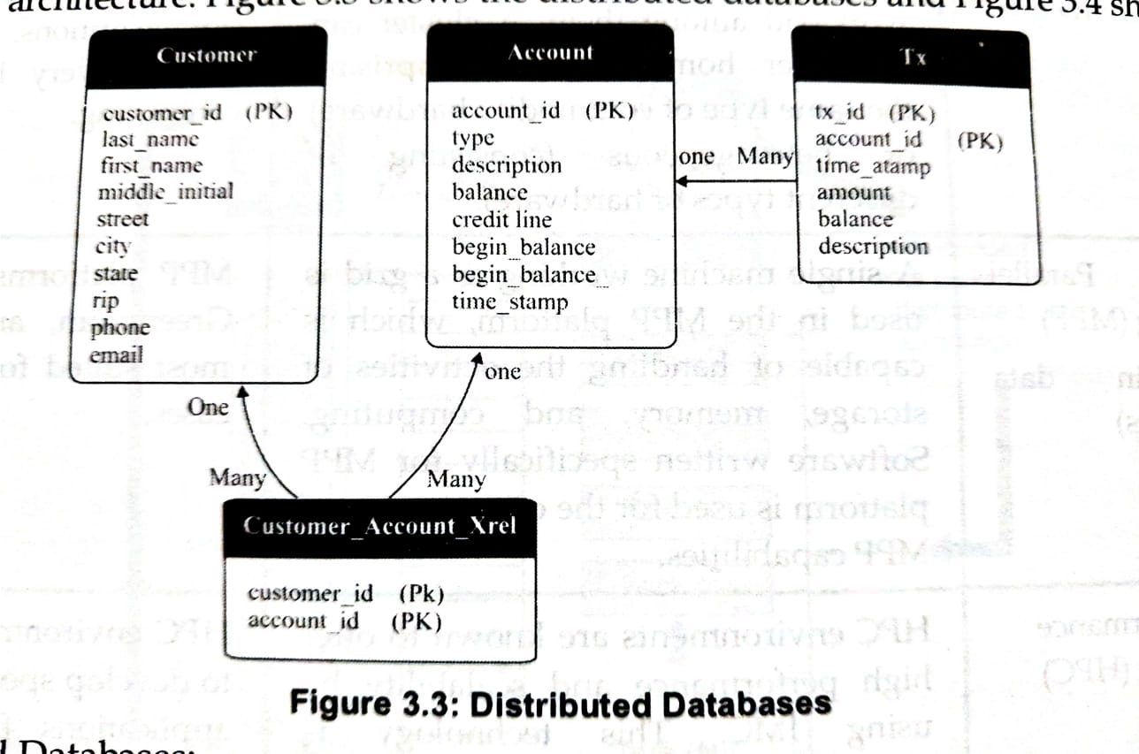
How data models and computing models differ?
Distributed databases:
Deal with tables and relations
Must have a schema for data
Implements data fragmentation and partitioning

Slide 28
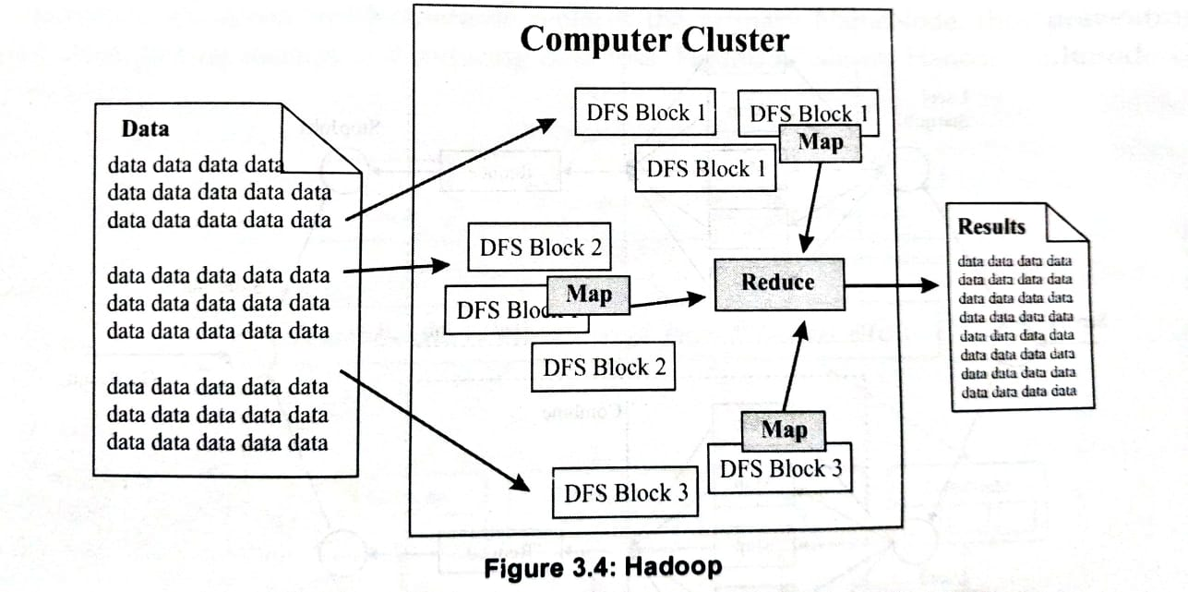
How data models and computing models differ?
Hadoop:
Deals with flat files in any format
Operates on no schema for data
Divides files automatically into blocks

Slide 29
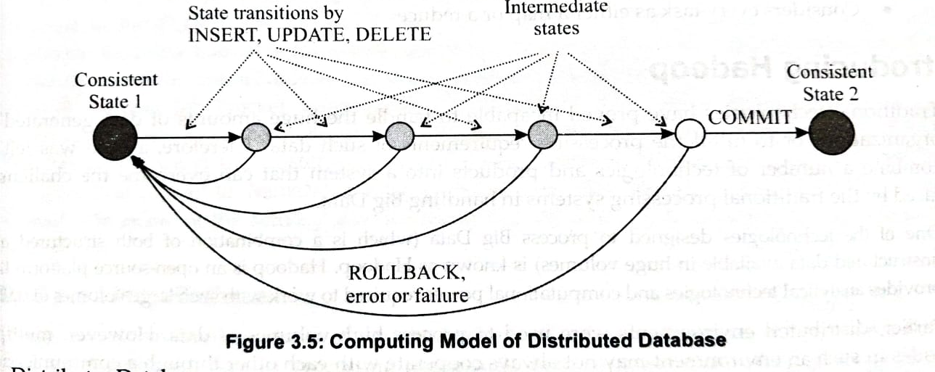
Computing model of Distributed database
Distributed databases:
Generate notations of a transaction
Implement ACID transaction properties
Allow distributed transactions

Slide 30
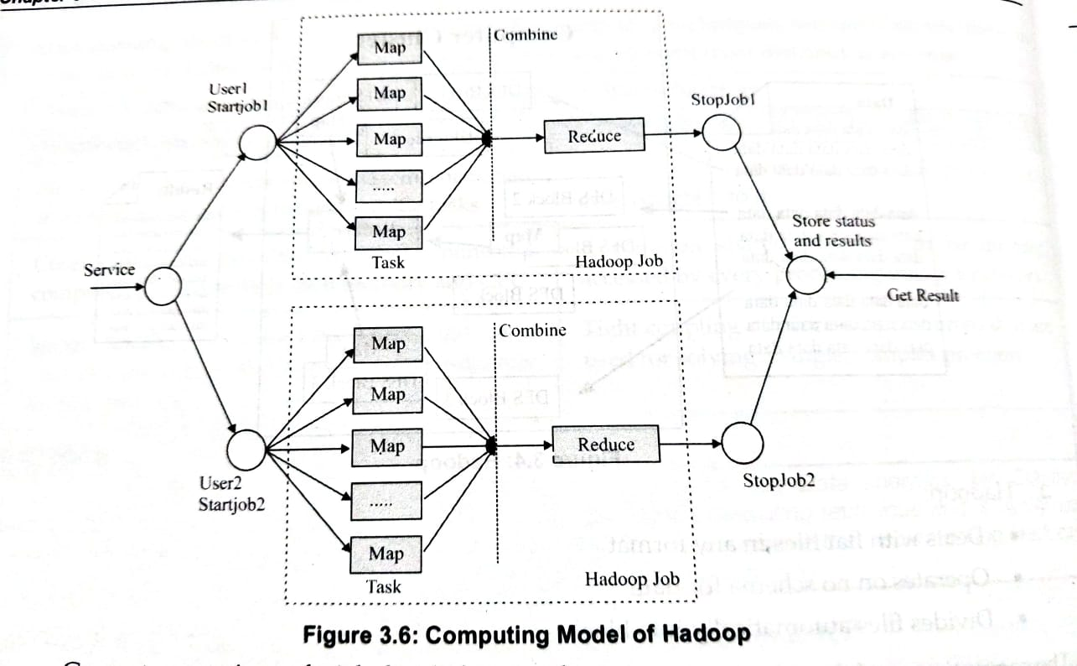
Computing model of Hadoop
Hadoop
Generates notations of a job divided into tasks
Implements MapReduce computing model
Considers every task as either map or a reduce

Slide 31

Introducing Hadoop
Hadoop is an open-source software framework that stores and processes large amounts of data.
It is based on the MapReduce programming model, which allows for the parallel processing of large datasets.
Hadoop is used for big data and analytics jobs.
It breaks workloads down into smaller workloads that can be run at the same time.
Hadoop allows clustering multiple computers to analyze massive datasets in parallel more quickly.

Slide 32
Hadoop Multi node Cluster Architecture
Hadoop cluster consist of Single Master Node and Multiple Worker Nodes.
Master Node
NameNode
JobTracker – Master node that manages all jobs and resources in a cluster of commodity computers
Worker Node
DataNode
TaskTrackers – Agents deployed at each machine in the cluster to run the map and reduce task at the terminal.
In a larger cluster, HDFS is managed through a NameNode server to host the file system index.
Secondary NameNode that keeps snapshots of NameNodes and at the time of failure of NameNode, the secondary NameNode replaces the primary NameNode, this preventing file system from getting corrupt and reducing data loss.

Slide 33
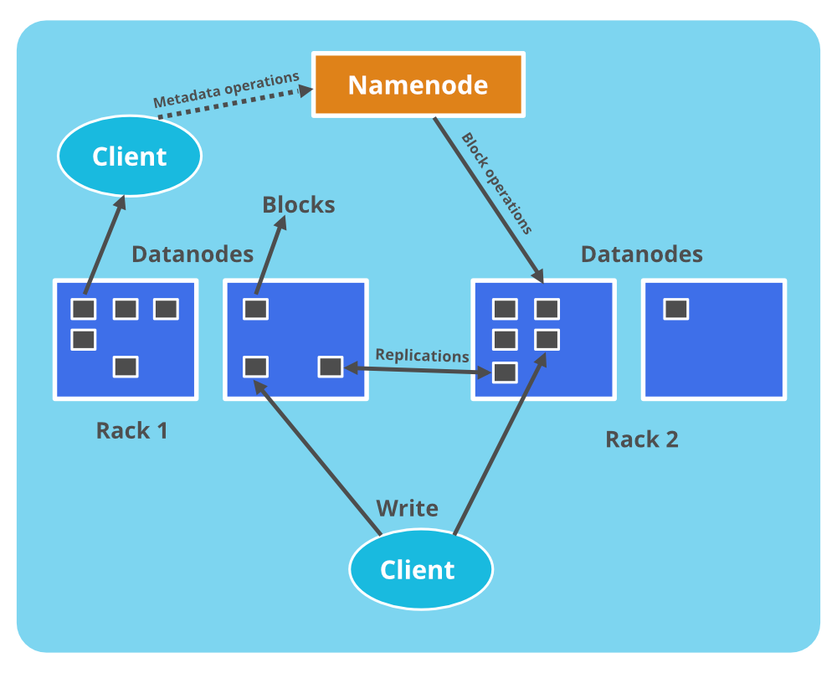
Name node - Operations
Name node maintains and manages the Data Nodes and assigns the task to them.
Name node does not contain actual data of files.
Name node stores metadata of actual data like Filename, path, number of data blocks, block IDs, block location, number of replicas and other slave related information's.
Name node manages all the request(read, write) of client for actual data file.
Name node executes file system name space operations like opening/closing files, renaming files and directories.

Slide 34
Data node - Operations
Data nodes is responsible of storing actual data.
Upon instruction from Name node, it performs operations like creation/replication/deletion of data blocks.
When one of Data node gets down then it will not make any effect on Hadoop cluster due to replication.
All Data nodes are synchronized in the Hadoop cluster in a way that they can communicate with each other for various operations.

Slide 35

Hadoop Multi node Cluster Architecture
If a data node cluster goes down while processing is going on, then the NameNode should know that some data node is down in the cluster, otherwise it can’t continue processing.
Each Data Node sends a “Heartbeat Signal” to NameNode after every few minutes to make NameNode aware of active/inactive status of DataNodes. –Heartbeat Mechanism.
Ref :
https://www.geeksforgeeks.org/how-does-namenode-handles-datanode-failure-in-hadoop-distributed-file-system/?ref=lbp

Slide 36
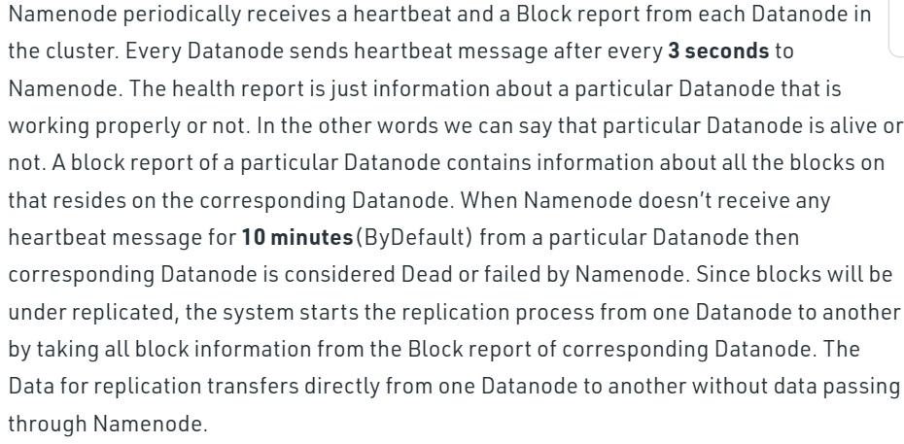
What happens if one of the Datanodes gets failed in HDFS?

Slide 37
HDFS and MapReduce
Two main components
Apache Hadoop – the Hadoop Distributed File System(HDFS) –used for storage.
MapReduce –used for processing

Slide 38
Hadoop Distributed File System(HDFS)
Hadoop Distributed File System(HDFS)
Fault tolerant storage system
Stores large size files from terabytes to petabytes.
Attains reliability by replicating the data over multiple hosts.
The default replication value is 3.
File in HDFS is split into large block size of 64MB.
Each block is independently replicated at multiple data nodes.

Slide 39
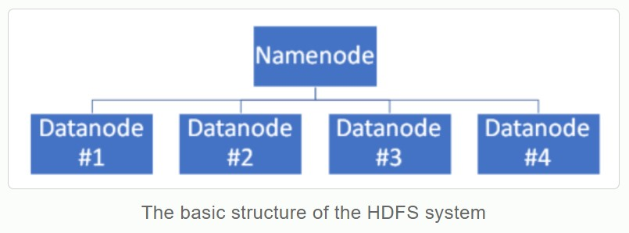
Hadoop Distributed File System(HDFS)
HDFS is like a tree in which there is a name node (the master) and data nodes (workers).
The name node is connected to the data nodes, also known as commodity machines where data is stored.
The name node contains the job tracker which manages all the filesystems and the tasks to be performed.
Understanding HDFS using Legos
https://www.youtube.com/watch?v=4Gfl0WuONMY

Slide 40
Understand Hadoop - Example
If a researcher wants to identify the calls made by the college students in a city on the occasion of an event.
The fields required – timing of the event and relevant information of the student.
The query is fired to search the results from the call records stored with the machine, which return relevant results that are collected in csv file.
The processing starts by first loading the data into Hadoop and then applying the MapReduce model.
Consider the columns u_id,u_name,c_name,sp_name,call_time are obtained in csv file.
To obtain final output, each mapper receives data line by line. Once the mapper receives its job, the results are shuffled or sorted by the Hadoop framework, which combines data in groups that are forwarded to reducer,
The final output is obtained by the reducer.

Slide 41
Features of Hadoop
Open Source
Highly Scalable Cluster
Fault tolerance is available
Flexible
Easy to use
Provides faster data processing

Slide 42
MapReduce
MapReduce
Used for processing large distributed datasets parallelly.
MapReduce is a process of two phases
The Map phase takes in a set of data which are broken down into key-value pairs.
The Reduce phase - The output from the Map phase goes to the Reduce phase as input where it is reduced to smaller key-value pairs
The key-value pairs given out by the Reduce phase is the final output of the MapReduce process

Slide 43

MapReduce
Hadoop accomplishes its operations(dividing the computing tasks into subtasks that are handled by individual nodes) with the help of MapReduce model – comprises two functions – Mapper and Reducer.
Mapper function – Responsible for mapping the computational subtasks to different nodes.
Reducer function – Responsible of reducing the responses from compute nodes, to a single result.
In MapReduce algorithm, the operations of distributing task across various systems, handling task placement for load balancing and managing the failure recovery are accomplished by mapper function.
The reducer function aggregates all the elements together after the completion of the distributed computation.

Slide 44
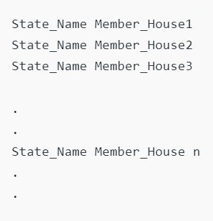
MapReduce Example
Suppose the Indian government has assigned you the task to count the population of India. You can demand all the resources you want, but you have to do this task in 4 months. Calculating the population of such a large country is not an easy task for a single person(you). So what will be your approach?.
One of the ways to solve this problem is to divide the country by states and assign individual in-charge to each state to count the population of that state.
Task Of Each Individual: Everyone must visit every home present in the state and need to keep a record of each house members as:

Slide 45
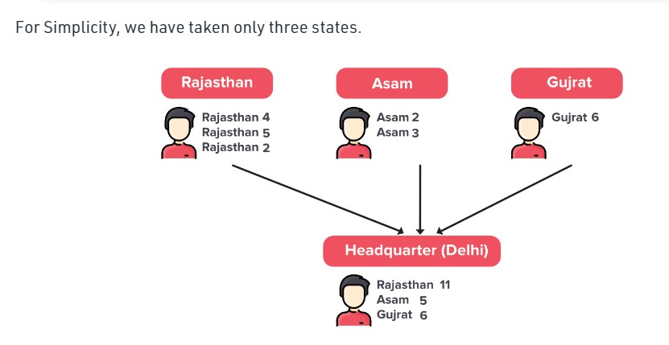
MapReduce Example

Slide 46
MapReduce Example
This is a simple Divide and Conquer approach and will be followed by each individual to count people in his/her state.
Once they have counted each house member in their respective state. Now they need to sum up their results and need to send it to the Head-quarter at New Delhi.
We have a trained officer at the Head-quarter to receive all the results from each state and aggregate them by each state to get the population of that entire state. and Now, with this approach, you are easily able to count the population of India by summing up the results obtained at Head-quarter.
The Indian Govt. is happy with your work and the next year they asked you to do the same job in 2 months instead of 4 months. Again you will be provided with all the resources you want.

Slide 47
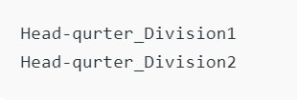
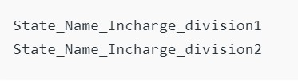
MapReduce Example
Since the Govt. has provided you with all the resources, you will simply double the number of assigned individual in-charge for each state from one to two. For that divide each state in 2 division and assigned different in-charge for these two divisions as->
Similarly, each individual in charge of its division will gather the information about members from each house and keep its record.
We can also do the same thing at the Head-quarters, so let’s also divide the Head-quarter in two division as->

Slide 48
MapReduce Example
Now with this approach, you can find the population of India in two months. But there is a small problem with this, we never want the divisions of the same state to send their result at different Head-quarters then, in that case, we have the partial population of that state in Head-quarter_Division1 and Head-quarter_Division2 which is inconsistent because we want consolidated population by the state, not the partial counting.
One easy way to solve is that we can instruct all individuals of a state to either send there result to Head-quarter_Division1 or Head-quarter_Division2. Similarly, for all the states.
Our problem has been solved, and you successfully did it in two months.
Now, if they ask you to do this process in a month, you know how to approach the solution.
Great, now we have a good scalable model that works so well. The model we have seen in this example is like the MapReduce Programming model. so now you must be aware that MapReduce is a programming model, not a programming language.

Slide 49
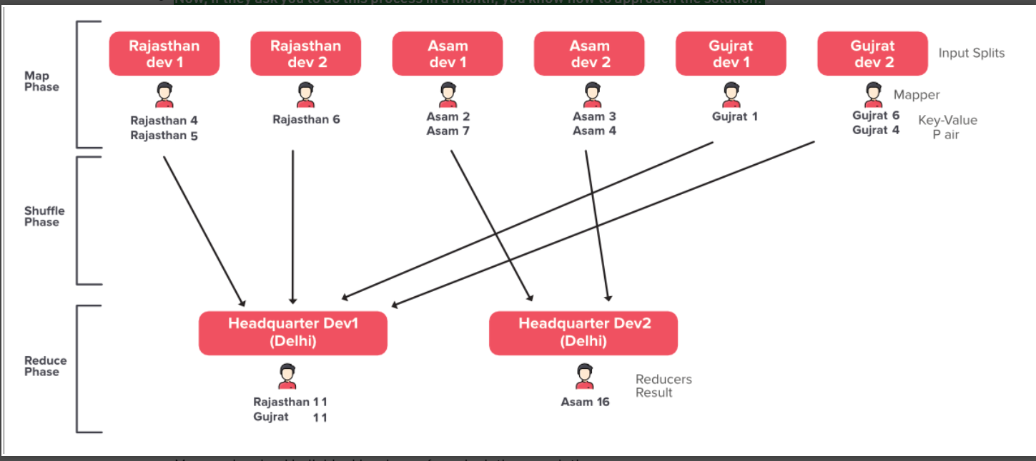

Slide 50
MapReduce Example
1. Map Phase: The Phase where the individual in-charges are collecting the population of each house in their division is Map Phase.
Mapper: Involved individual in-charge for calculating population
Input Splits: The state or the division of the state
Key-Value Pair: Output from each individual Mapper like the key is Rajasthan and value is 2
2. Reduce Phase: The Phase where you are aggregating your result
Reducers: Individuals who are aggregating the actual result. Here in our example, the trained-officers. Each Reducer produce the output as a key-value pair
3. Shuffle Phase: The Phase where the data is copied from Mappers to Reducers is Shuffler’s Phase. It comes in between Map and Reduces phase.

Slide 51
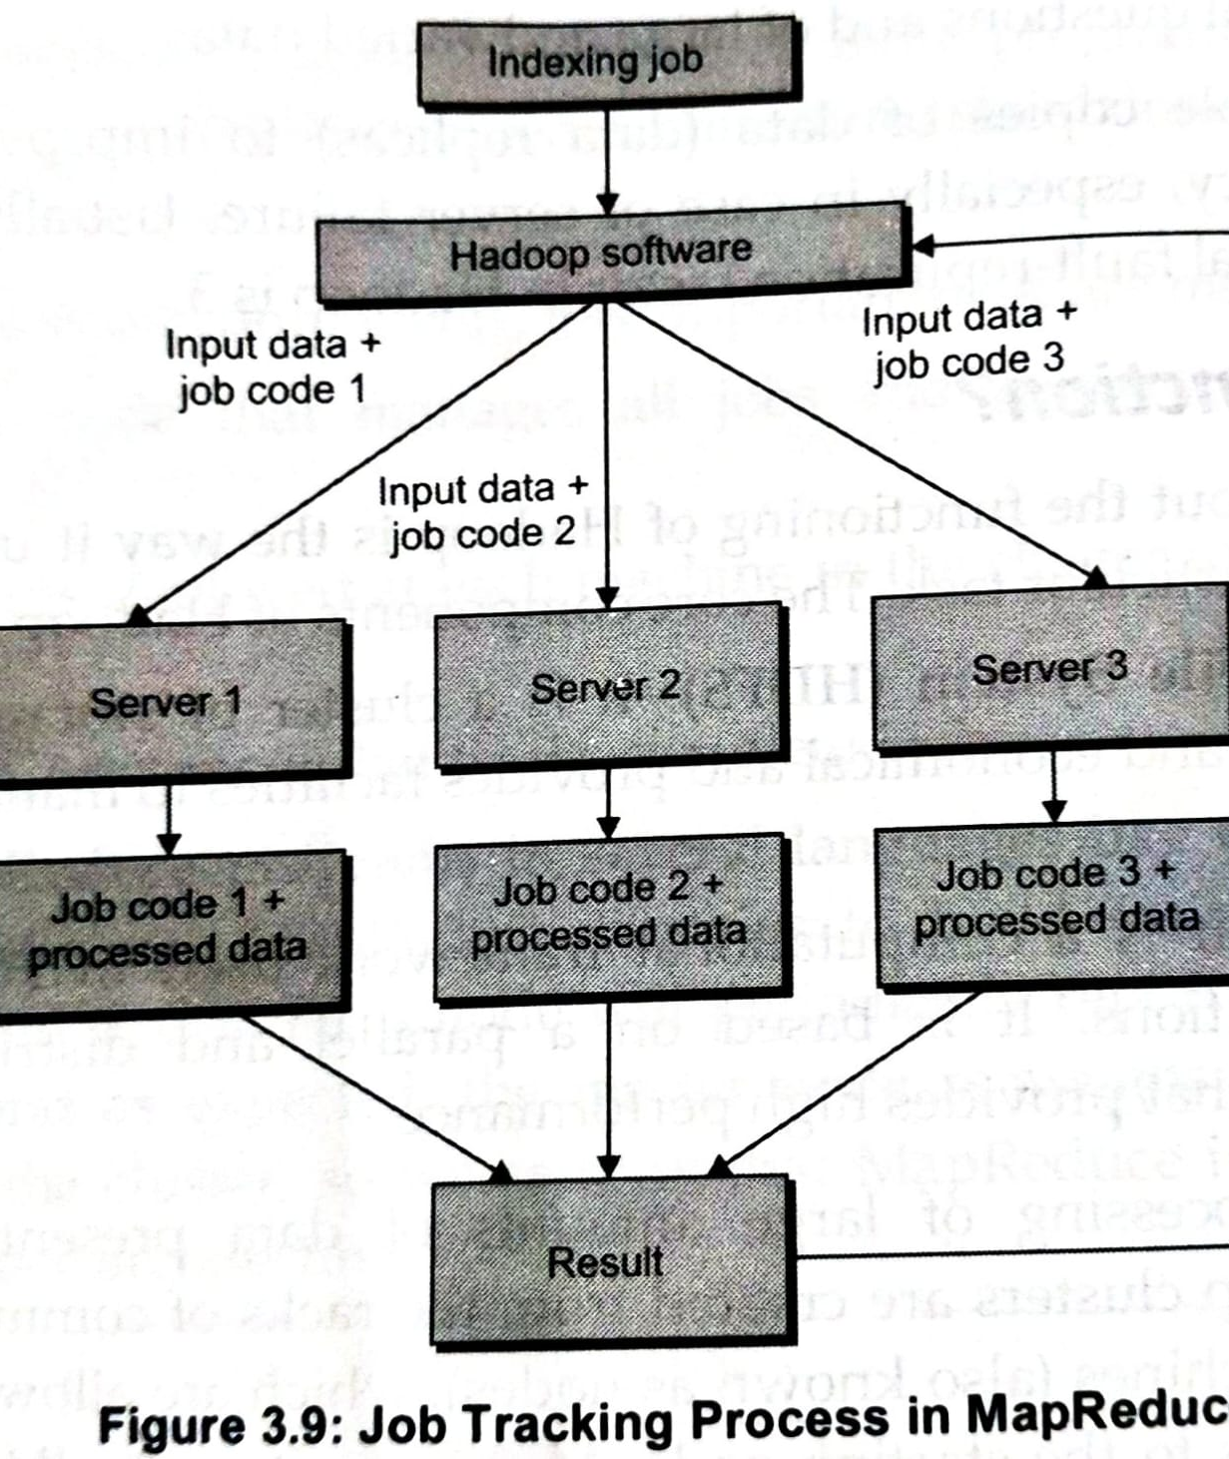
How does Hadoop function?
When an indexing job is provided to Hadoop, it requires organizational data to be loaded first.
Next, the data is divided into various pieces, and each piece is forwarded to different individual servers.
Each server has a job code with the piece of data it is required to process.
The job code helps Hadoop to track the current state of data processing.
Once the server completes operations on the data provided to it, the response is forwarded with the job code being appended to the result.

Slide 52
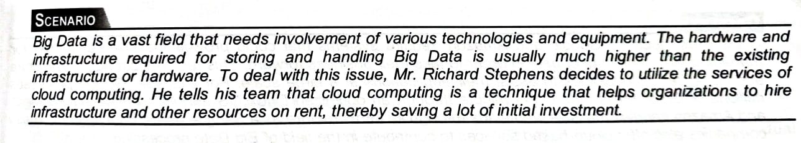
Cloud Computing and Big Data

Slide 53
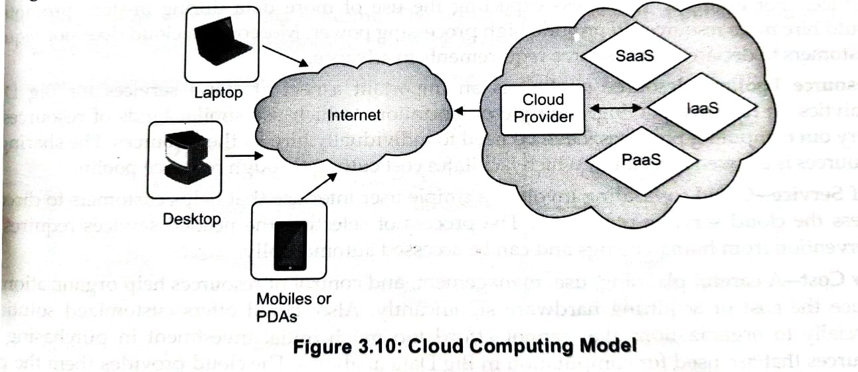
Cloud Computing and Big Data
Cloud Computing is the delivery of computing services—servers, storage, databases, networking, software, analytics and more—over the Internet (“the cloud”).
Companies offering these computing services are called cloud providers and typically charge for cloud computing services based on usage, similar to how you are billed for water or electricity at home.

Slide 54

Cloud Computing and Big Data
The cloud computing environment saves costs related to infrastructure on an organization providing a framework that can be optimized and expanded horizontally.
Cost to be paid for acquiring cloud services i.e., resource acquisition in accordance with requirements and cost is known as elasticity.
Cloud computing regulate the rise of computing resources i.e., payment can be done only for the resources to be accessed.
Organization to need to plan, monitor and control its resource utilization carefully, else, it can lead to unexpected high costs.

Slide 55
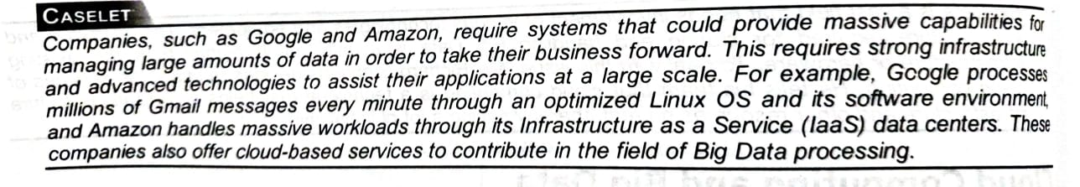
Cloud Computing and Big Data
The cloud computing technique uses data centres to collect the data and ensures the data back up recovery are automatically performed to meet the organization requirements.
Both cloud computing and big data analytics use the distributed computing model in a similar manner.

Slide 56
Features of Cloud Computing
Scalability
Addition of new resources to an existing infrastructure.
The increase in the amount of data , requires organization to improve hardware components processing ability.
The new hardware may not provide complete support to the software that used to run properly on the earlier set of hardware.
Solution to this problem is using cloud services-that employ the distributed computing technique to provide scalability.
Elasticity
Hiring certain resources, as and when required, and paying for those resources.
No extra payment is required for acquiring specific cloud services.
Fault Tolerance
Offering uninterrupted services to customers, especially in cases of component failure.

Slide 57
Features of Cloud Computing
Resource Pooling
Multiple organizations, which use similar kinds of resources to carry out computing practices, have no need to individually hire all the resources.
The sharing of resources is allowed in a cloud, which facilitates cost cutting through resource pooling.
Self Service
Cloud computing involves a simple user interface that helps customers to directly access the cloud services they want.
Low Cost
Cloud offers customized solutions, especially to organizations that cannot afford too much initial investment.
Cloud provides pay-us-you-use option, in which organizations need to sign for those resources only that are essential.

Slide 58
Cloud Deployment Models
Depending upon the architecture used in forming the n/w, services and applications used, and the target consumers, cloud services form various deployment models.
They are,
Public Cloud
Private Cloud
Community Cloud
Hybrid Cloud

Slide 59
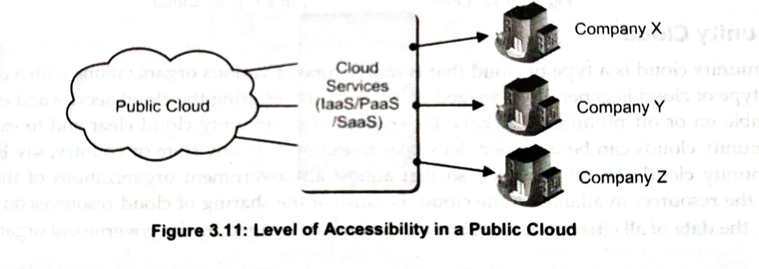
Public Cloud(End-User Level Cloud)
Owned and managed by a company than the one using it.
Third party administrator.
-Eg : Verizon, Amazon Web Services, and Rackspace.
-The workload is categorized on the basis of service category; hardware customization is possible to provide optimized performance.
-The process of computing becomes very flexible and scalable through customized hardware resources.
-The primary concern with a public cloud include security and latency.

Slide 60
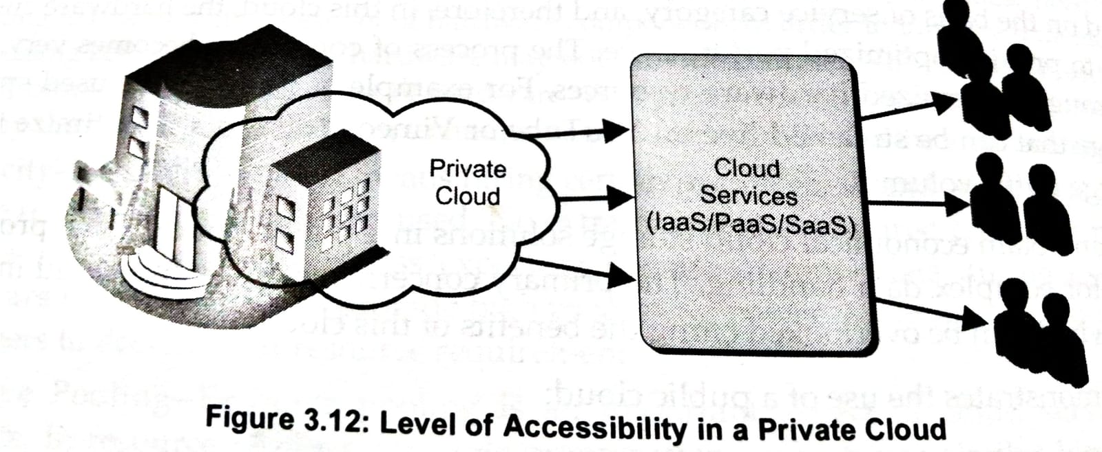
Private Cloud(Enterprise Level Cloud)
Remains entirely in the ownership of the organization using it.
Infrastructure is solely designed for a single organization.
Can automate several processes and operations that require manual handling in a public cloud.
Can also provide firewall protection to the cloud, solving latency and security concerns.
A private cloud can be either on-premises or hosted externally
on premises : service is exclusively used and hosted by a single organization.
Hosted externally : used by a single organization and are not shared with other organizations.

Slide 61
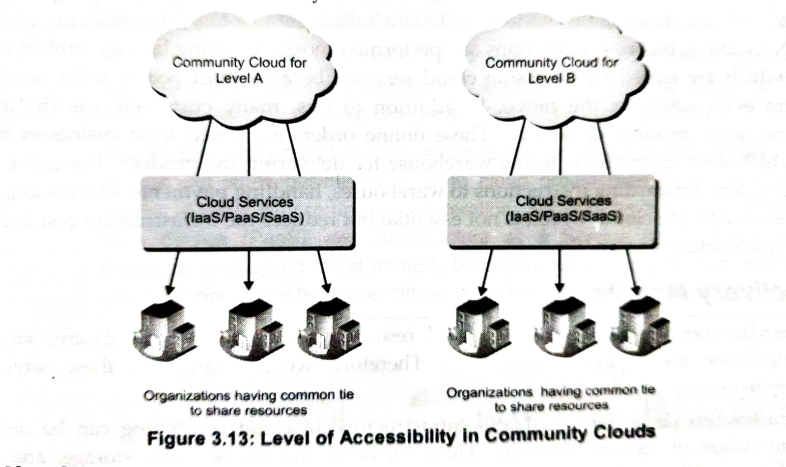
Community Cloud
Type of cloud that is shared among various organizations with a common tie.
-Managed by third party cloud services.
-Available on or off premises.
Example:
In any state, the community cloud can provide so that almost all govt. organizations of that state can share the resources available on the cloud. Because of the sharing of resources on community cloud, the data of all citizens of that state can be easily managed by the govt. organizations.

Slide 62
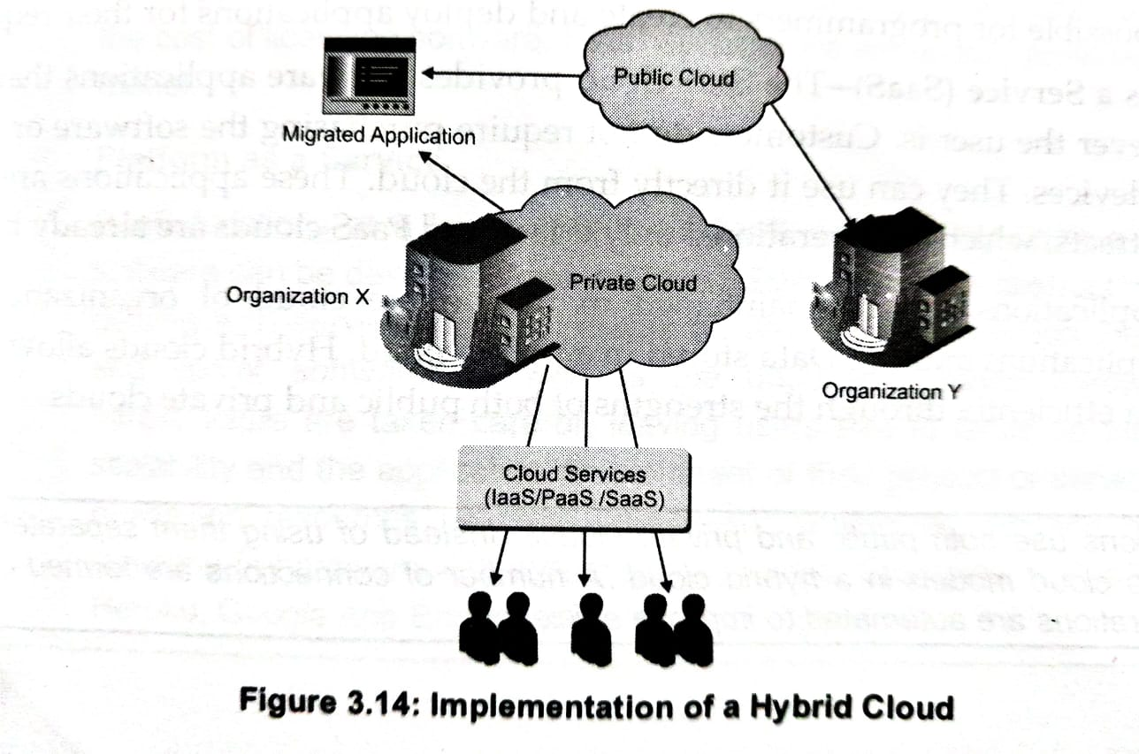
Hybrid Cloud
Various internal or external service providers offer services to many organizations.
In hybrid clouds, an organization can use both types of cloud, i.e. public and private together –situations such as cloud bursting.
Organization uses its own computing infrastructure, high load requirement, access clouds.
The organization using the hybrid cloud can manage an internal private cloud for general use and migrate the entire or part of an application to the public cloud during the peak periods.

Slide 63
Cloud services for Big Data
In big data Iaas(Infrastructure As A Service), Paas (Platform As A Service), and Saas (Software As A Service), clouds are used in following manner.
IaaS - Infrastructure as a service, or IaaS, delivers on-demand infrastructure resources to organizations via the cloud, such as compute, storage, networking, and virtualization. Customers don’t have to manage, maintain, or update their own data center infrastructure, but are responsible for the operating system, middleware, virtual machines, and any apps or data.
PaaS - Platform as a service, or PaaS, delivers and manages all the hardware and software resources to develop applications through the cloud. Developers and IT operations teams can use PaaS to develop, run, and manage applications without having to build and maintain the infrastructure or platform on their own. Customers still have to write the code and manage their data and applications, but the environment to build and deploy apps is managed and maintained by the cloud service provider.
SaaS - Software as a service, or SaaS, provides the entire application stack, delivering an entire cloud-based application that customers can access and use. SaaS products are completely managed by the service provider and come ready to use, including all updates, bug fixes, and overall maintenance. Most SaaS applications are accessed directly through a web browser, which means customers don’t have to download or install anything on their devices.

Slide 64
In-Memory Computing Technology for Big Data
Another way to improve speed and processing power of data.
IMC is used to facilitate high speed data processing e.g. IMC can help in tracking and monitoring the consumers activities and behaviors which allow organizations to take timely actions for improving customer services and hence customer satisfaction.
Data stored on external devices known as secondary storage space. This data had to be accessed from external source.
In the IMC technology the RAM or Primary storage space is used for analyzing data. Ram helps to increase computing speed.
Also, reduction in cost of primary memory has helped to store data in primary memory.

Slide 65
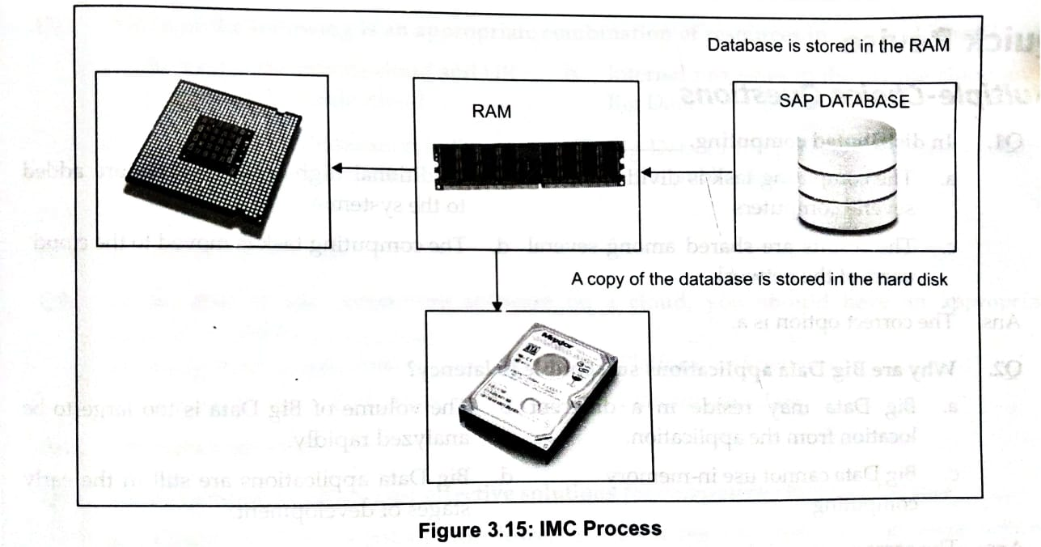
In-Memory Computing Technology for Big Data
Working of IMC:
Relational Databases(RDBs) are used to store relational data and are the sources of information that are obtained by using SQL queries.
The data stored in the RDB’s is mostly structured, for example, accessing your marksheet from the college’s website by filling in your roll number,
Unstructured data, comprises of wide range of texts, images, videos, blogs etc are obtained by searching for specific words.
Entering a name in Google search to find the webpage is an example of accessing unstructured data.
The volume-related issues are addressed by using IMC, and the diversity of Big data by using NoSQL databases.
Large organizations have centralized data warehouses for keeping the data safe.
The IMC technology helps different business units of organizations to access and process the data which reduces the load on central warehouse as every department takes care of processing its own data.

